Slide 1
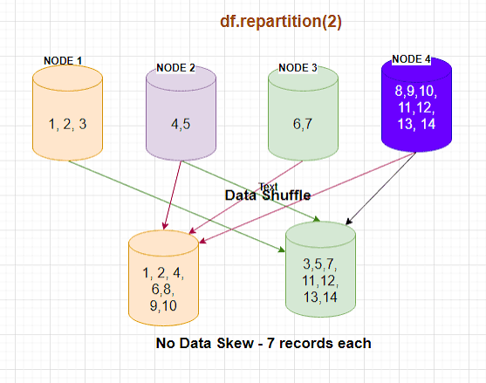
repartition()
A wide transformation used to change the number of RDD partitions after instantiation. It shuffles data as evenly as possible across the cluster, optimizing performance and allowing for both upscaling and downscaling.
Spark can only run a single task per partition, so adding more partitions improves parallel execution.
There are 3 ways to use repartition():
By number - give a fixed number of partitions
rdd.repartition(10)
By column - hash-partition based on column values
rdd.repartition(“country”)
By both number and column
rdd.repartition(10, “country”)

Slide 2
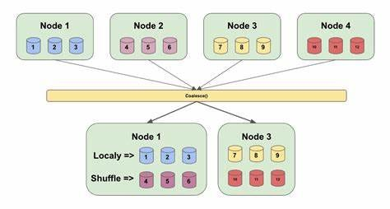
coalesce()
A narrow transformation used to reduce the number of partitions in a dataset. Instead of shuffling all remaining partitions, coalesce() merges adjacent partitions on the same executor.
rddReduced = rdd.coalesce(5)

Slide 3
repartition() vs. coalesce()
While repartition has to shuffle the entire dataset to redistribute it evenly, coalesce simply appends the displaced data to the nearest executor, saving time and system resources. However, this also means that the distribution of data across the partitions is uneven, resulting in some partitions having a higher workload than others.
Repartition is generally preferred for workload balancing or if you need to organize data based on specific columns, while coalesce is preferred for cleanup before writes or after filtering.

Slide 4
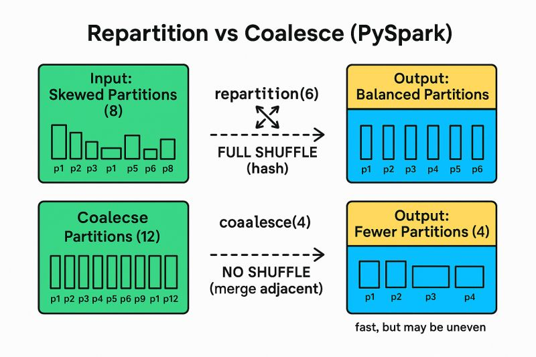
repartition() | coalesce()
Increase or decrease partition count | Only decrease partition count
Wide transformation | Narrow transformation
Shuffle | No shuffle
Expensive (disk/network I/O) | Fast and Efficient
Uniform distribution | Uneven distribution

Slide 5
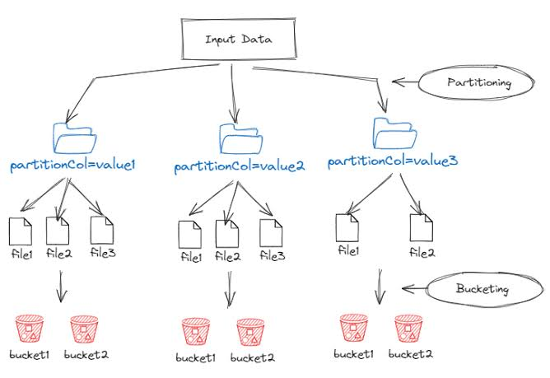
partitionBy()
A wide transformation that organizes data into subdirectories based on unique values in one or more columns. This creates a hive-style directory for cleaner storage.
df.write.partitionBy(“year”)
When a partitioned dataset is queried on the partitioned column, Spark skips all other directories entirely. This speeds up reads by up to to 50x-100x.
SELECT * FROM df WHERE year = 2026

Slide 6
Bucketing
Bucketing is a data storage technique used to improve query performance for large datasets. It divides the data to be stored among a fixed number of buckets, each stored as a separate file.
df.write.bucketBy(5, “age”).saveAsTable(“table_name”)
Storing data in buckets allows Spark to narrow down queries by only checking specific buckets, improving query speed. Additionally, uniform bucket size ensures all buckets have roughly the same number of records, preventing data skew.

Slide 7
Bucketing vs. partitionBy()
While these two techniques are similar, they focus on different areas of data storage and can be used in tandem. Partitioning focuses more on parallel processing distribution and how the data is organized. Bucketing, however, focuses more on query performance and efficient data storage in large datasets.

